Slide 1


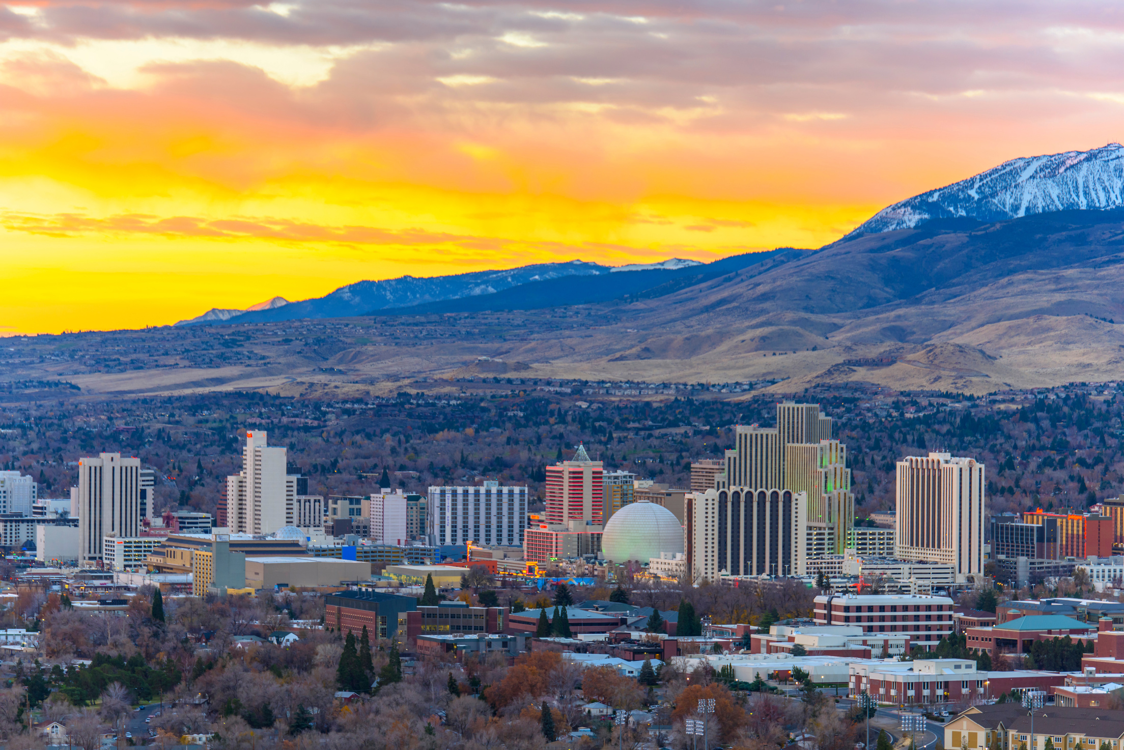



Courage Worldwide
NEVADA’S CHILDREN ARE
NOT FOR SALE
A CHILD SEX TRAFFICKING SUMMIT
Join us as we dispel the myths surrounding child sex trafficking, define the issue, and broaden our community’s ability to serve our most vulnerable children with available resources.
May 9, 2025 at 8:00 AM
Learn more at

