Slide 1
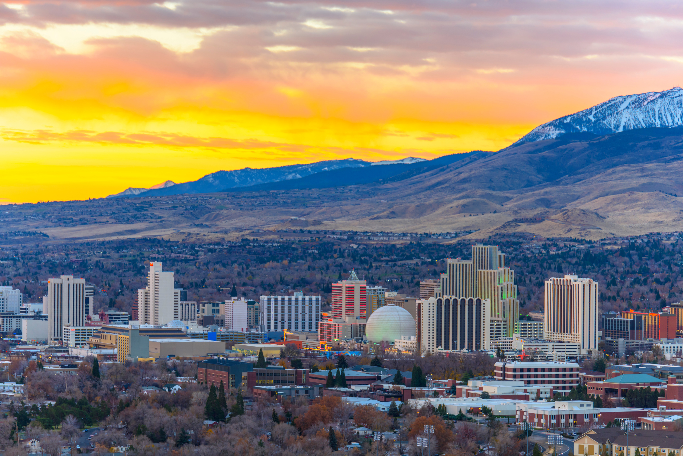

May 9, 2025 | 8 AM - 5 PM
Nevada’s Children Are
Not For Sale
A CHILD SEX TRAFFICKING SUMMIT
Learn About Trafficking
Join the Anti-Trafficking Movement
Join us as we dispel the myths surrounding child sex trafficking, define the issue, and broaden our community’s ability to serve our most vulnerable children with available resources.
Learn more and register today:
Hosted by Courage Worldwide

