Slide 1
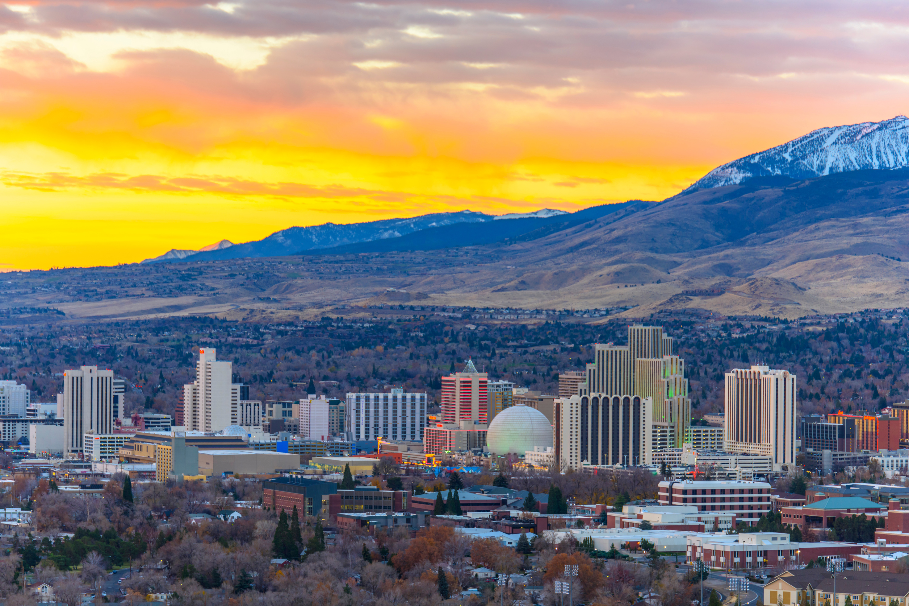

HOSTED BY
COURAGE
WORLDWIDE
May 9th | 8:00AM - 5:00PM
NEVADA’S CHILDREN ARE
2025
NOT FOR SALE
A CHILD SEX TRAFFICKING SUMMIT
Learn more and register today:

